Slide 1
Introducing Windows Communication Foundation
Ronnie Holm
Lecture 9

Slide 2
Agenda
Introducing WCF
Service-oriented architecture
Demo: creating a Hello World service
ABCs of WCF
Metadata Exchange

Slide 3
Introducing WCF
Unified API for building distributed applications
Distributed refers not only to two networked computers, but also to two executables on the same machine
Running distributed system in-house vs. externally impacts choice of framework
Notes:
- Running distributed system in-house means - You have greater control over OS and frameworks used (.NET/COM/Java) - Can leverage existing authentication and authorization infrastructure - You might pick a distributed technology that ties you to OS and framework for performance - Running an external, distributed system means - Not being able to dictate OS, framework, and security settings - Technologies predating WCF - DCOM - COM+ - MSMQ - .NET remoting - With WCF, you can plug and play the underlying plumping, yet keep your code constant - No need to change your code if you change binding (from XML to binary) - Most times you only need to modify your service’s configuration file

Slide 4
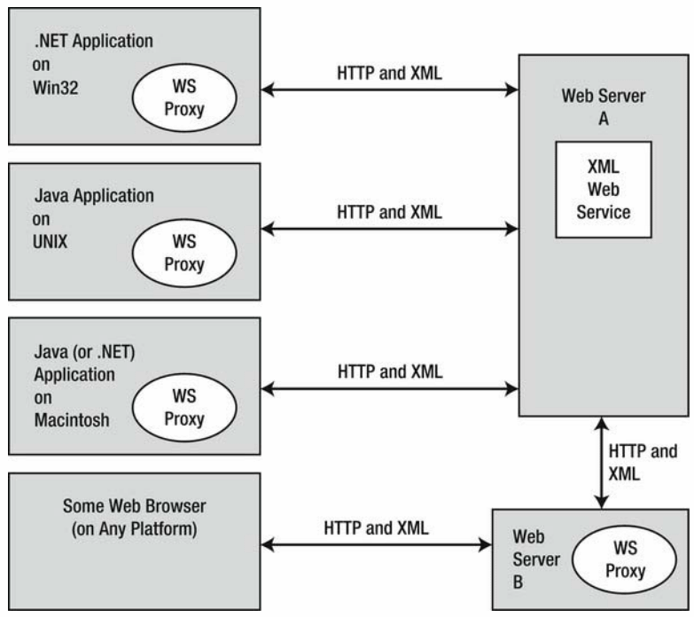
Introducing WCF (2)
XML is the way to go when you need to expose “remote objects” to any OS and any programming model
WCF uses predominantly the HTTP protocol and XML as its message format
Notes:
- HTTP isn’t the fastest protocol - XML is a verbose means of communications - For in-house solutions, raw TCP offers better performance - Some standardization needs to be in place for services from different vendors to talk to each other - WS-* specifications specify standards for - Security - WSDL - SOAP formats - WCF supports many of the WS-* specifications

Slide 5
Service-oriented architecture
Create many smaller services that collectively provide the complete functionality of a complex piece of software
Tenets of SOA
Boundaries are explicit
Services are autonomous
Services communicate via contracts, not implementation
Service compatibility is based on policy
Notes:
- SOA is a design principle and a major buzzword - Enables reuse of code in many different contexts (or that was the idea) - SOA promotes loose coupling between components - SOA is a way to design a distributed system where several autonomous services work
in conjunction by passing messages across boundaries using well-defined interfaces - Boundaries are explicit - Only way an external caller can communicate with WCF service is through interface - Interface specifies each member, its parameters, and its return type - Services are autonomous - Each service is a self-contained application - Typically each service would have its own database - Services communicate via contract, not implementation - Implementation details of service are of no concern to callers - Service compatibility is based on policy
- Interfaces and WSDL alone aren’t expressive enough to detail every aspect of a service - Define policies that define semantic properties of the service, such as security requirements

Slide 6
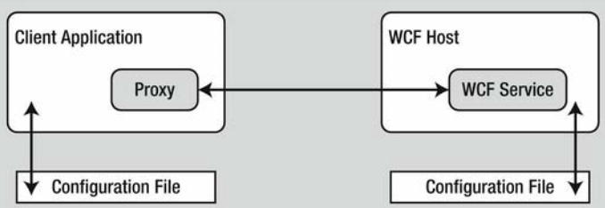
Demo: Creating a Hello World service
Show server and client code
Show WCF Test Client
Show browser-based WSDL file
Notes:
- Change configuration in *.config file rather than recompiling/redeploying apps

Slide 7
Building a WCF service
// server
[ServiceContract]
public interface IPersonService {
[OperationContract]
Person GetPerson(int id);
}
// client
static void Main(string[] args) {
var svc = new PersonServiceClient();
var p = svc.GetPerson(12);
Console.WriteLine(
p.Id + " " + p.Name);
}
[DataContract]
public class Person {
[DataMember]
public int Id { get; set; }
[DataMember]
public string Name { get; set; }
}
public class PersonService :
IPersonService {
public Person GetPerson(int id) {
return new Person {
Id = id,
Name = "John Doe" };
}
}

Slide 8
ABCs of WCF
Hosts and clients communicate with each other by agreeing on the ABCs
Address
scheme://<MachineName>[:port]/Path
Binding
HTTP, MSMQ, named pipes, TCP
XML, binary
Contract
ServiceContract, OperationContract, DataMember, DataContract, and many more attributes
Specify endpoint ABCs in *.config or code
Notes:
- When you create a service, the developer don’t have to define ABC in that order - Service contract - Interface that represents a WCF contract - Type is adorned with various attributes - Service type - Class (or structure) that implement the interface - You’re not required to use CLR interfaces to a WCF contract

Slide 9
Metadata Exchange (MEX)
WCF client communicates with WCF service through an intervening proxy
svcutil.exe generates a proxy based off of a WSDL file
Adding service reference from VS executes svcutil.exe behind the scenes
Enabling MEX behavior for a service exposes the WSDL to clients

